Slide 1

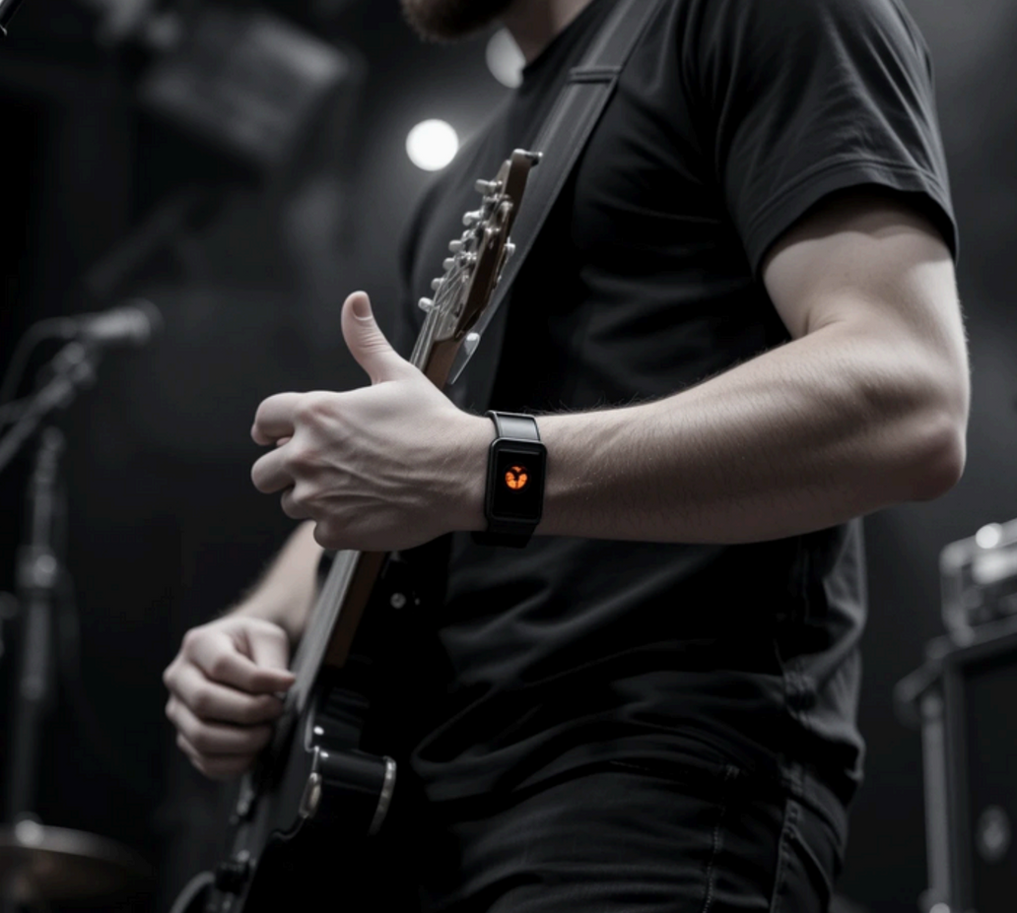

WIRELESS EMERGENCY ALERT SYSTEM FOR LIVE EVENTS
Presented by Group Debuggers
Manitha Ayanaja | Sachinthaka Dilhara | Kaveesha Divyanga | Mishen Janodya

Slide 2
PROBLEM
No effective way for musicians/ performers to alert failures to audio engineers/ crew during live events
Communication by hand signals or shouting is unreliable
Leads to delays, confusion, and poor audience experience
Traditional signaling methods are disrupting the performance.
Communication weakens in rough and noisy environments

Slide 3
PROBLEM VALIDATION
Conducted an online survey to gather real-world insights
Targeted individuals involved in music, live events, including students and event attendees.
Special focus was given to professionals in live bands, concert performers, and audio technicians
Responses confirmed a recurring issue with in-performance communication gaps and technical difficulties

Slide 4
YES. DURING ONE OF CONCERTS, MY GUITAR'S OUTPUT SOUND GOT LOW, BUT I COULD TELL IT TO THE SOUND ENGINEER.
YES , IN EAR SOUND ISSUES
YEP, THE DIFFICULTY IN BRIDGING SOUND,LIGHT AND VISUALS SIMULTANEOUSLY.
YES, PASSING MESSAGE TO AUDIO ENGINEER AND COMMUNICATION ISSUES DURING THE EVENT TIME
MOSTLY THE INSTRUMENT FAILURES
AUDIO ISSUES, INSTRUMENT FAILURES
PROBLEMS
????
IN EAR MONITOR FAILURE IS THE MOST COMMON THING
YES , DIFFICULT TO COMMUNICATE WITH MOH ENGINEER/ TECHNICIAN / COORDINATOR
IN EAR MONITOR FAILURE
YES
EAR MONITOR FAILURE
TRANSITION DIFFICULTY

Slide 5
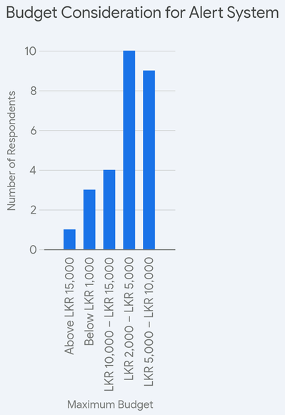
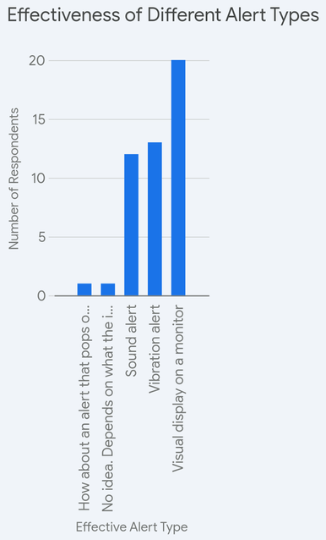
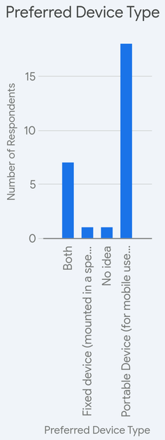
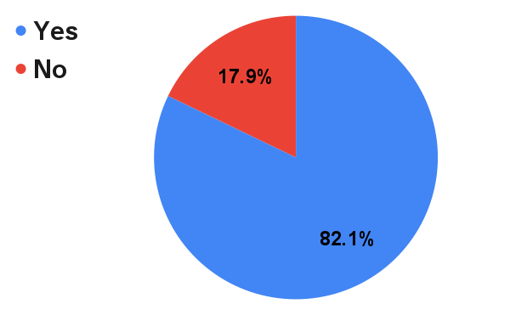
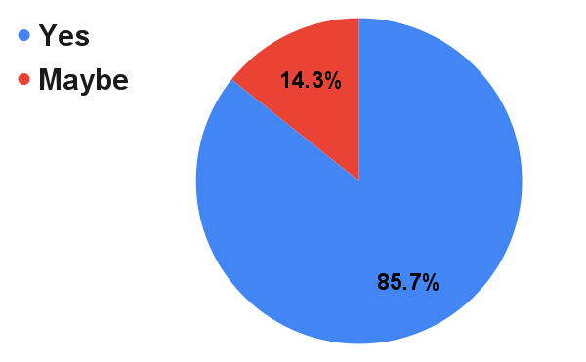
COMMUNICATION ISSUES FACED?
HELPFULNESS OF WIRELESS EMERGENCY ALERT SYSTEM

Slide 6
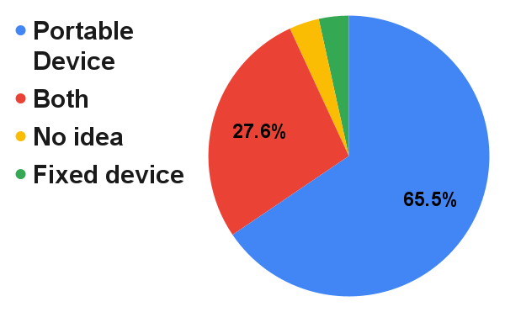
PREFERRED DEVICE TYPE

Slide 7
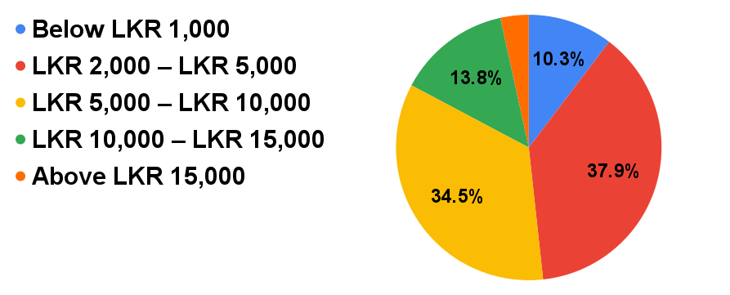
MAXIMUM BUDGET CONSIDERATION

Slide 8
ALTERNATIVES CONSIDERED
Bluetooth - Limited range
Wired Device - Restricts movement
Walkie-Talkies or Intercoms - Require verbal communication during performances, and can be disruptive on stage.
Mobile Phone Alerts - Not practical in live settings due to latency, network reliability, and the unprofessional appearance of using phones on stage.
Dedicated RF-Based Systems - Rejected due to higher cost, complexity in implementation, and limited scalability in dynamic event environments.

Slide 9
PROPOSED SOLUTION
Each device is initially configured via its own Wi-Fi hotspot, where the artist inputs their name and connects to the venue’s local Wi-Fi network
Once configured, the device sends alert signals over the local network
A central local server continuously listens for incoming alerts from multiple devices
The alert is then processed and displayed in real-time on a web-based application accessed by the audio engineer or technician
This architecture ensures low-latency, reliable communication within the performance environment

Slide 10
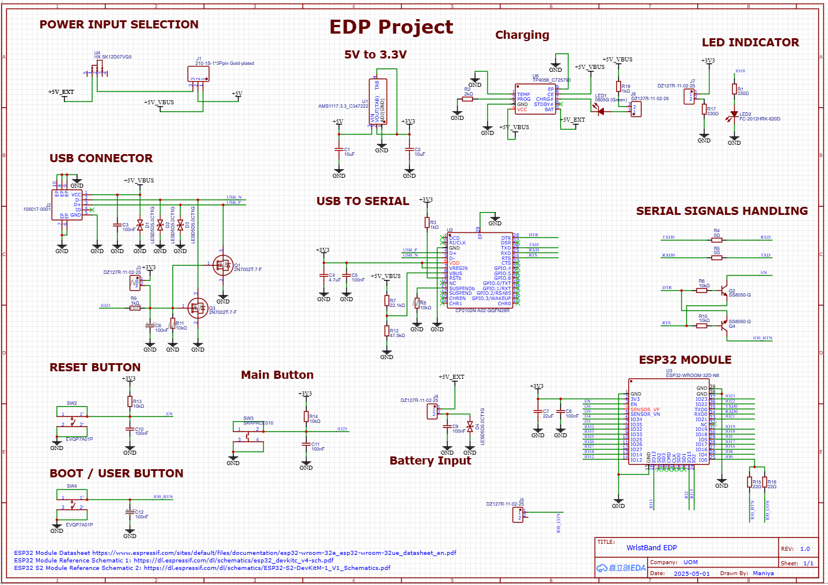
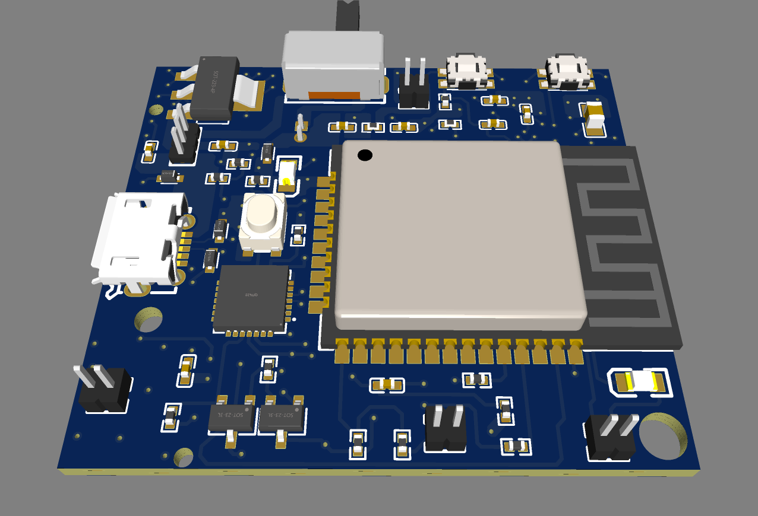
PCB

Slide 11
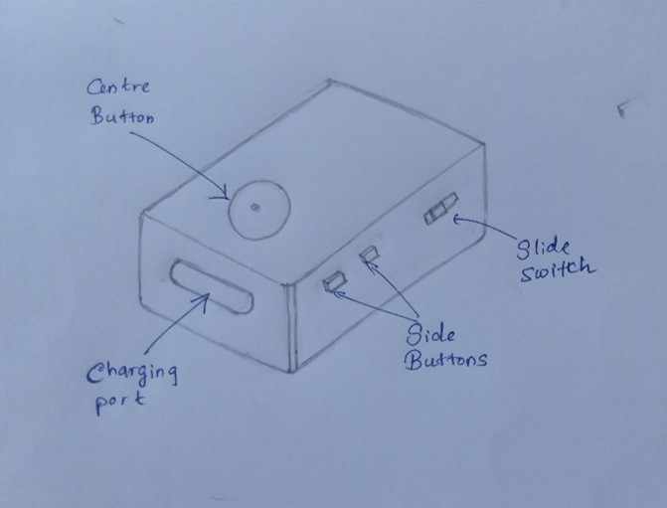
ENCLOSURE SKETCH

Slide 12
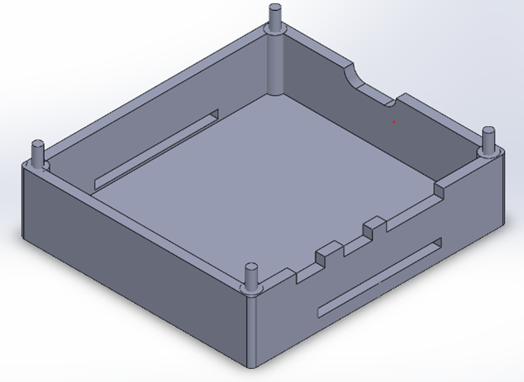
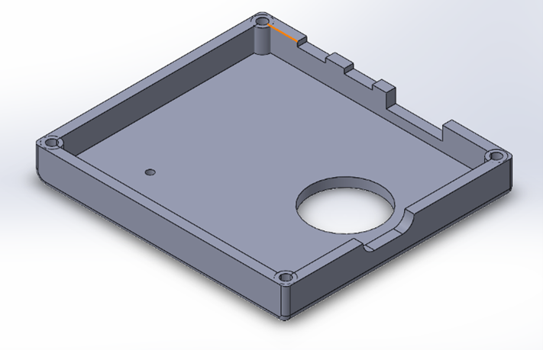
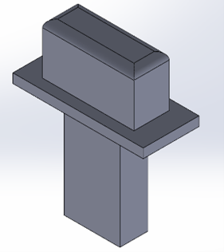
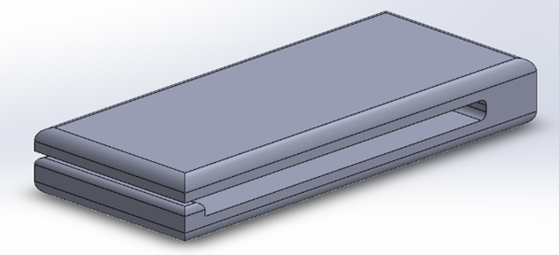
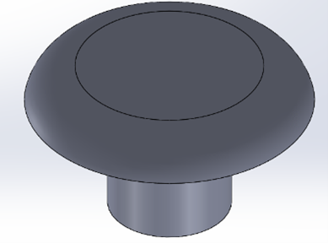
FINAL DESIGN

Slide 13
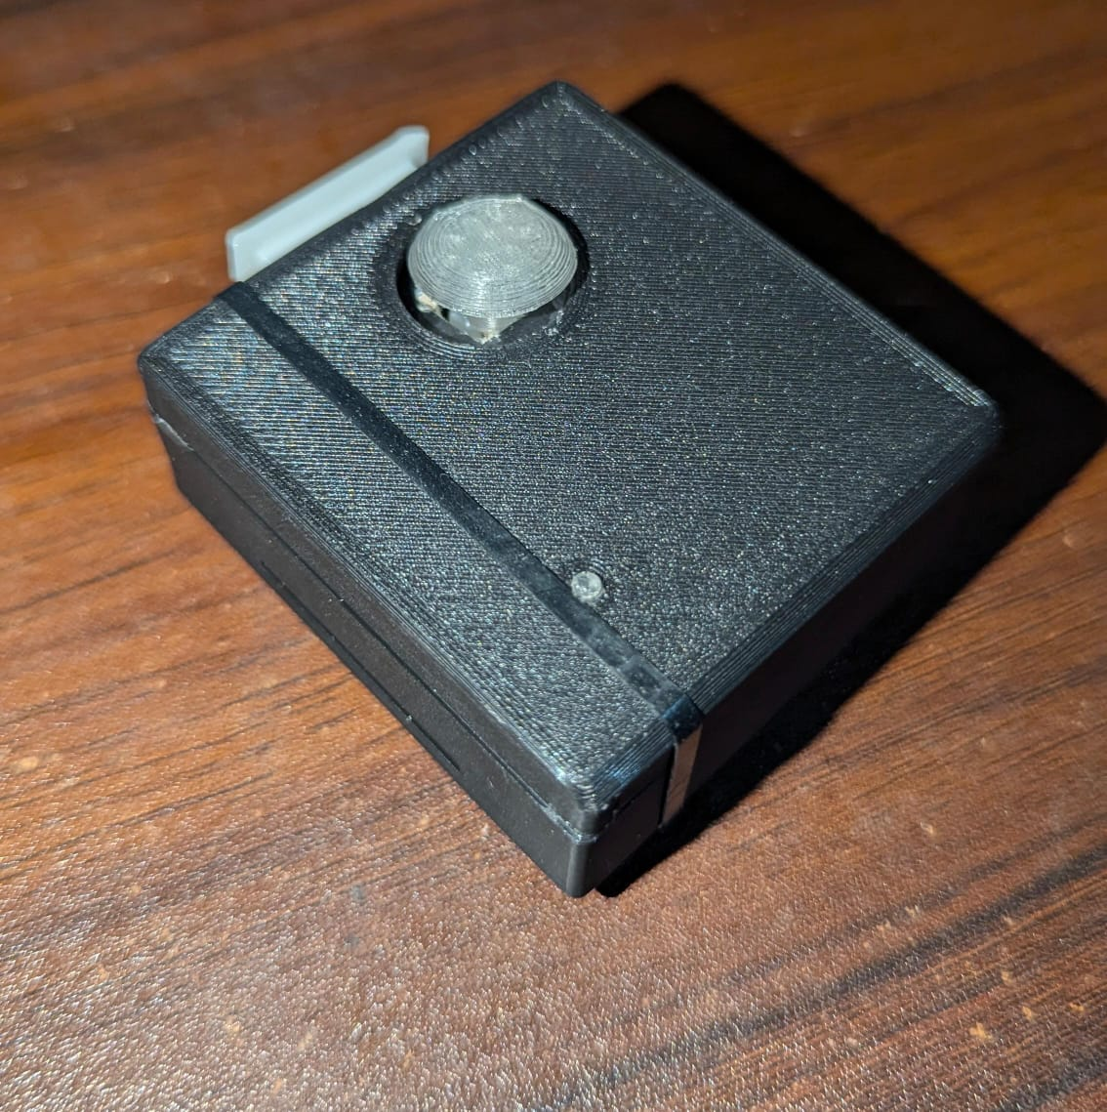
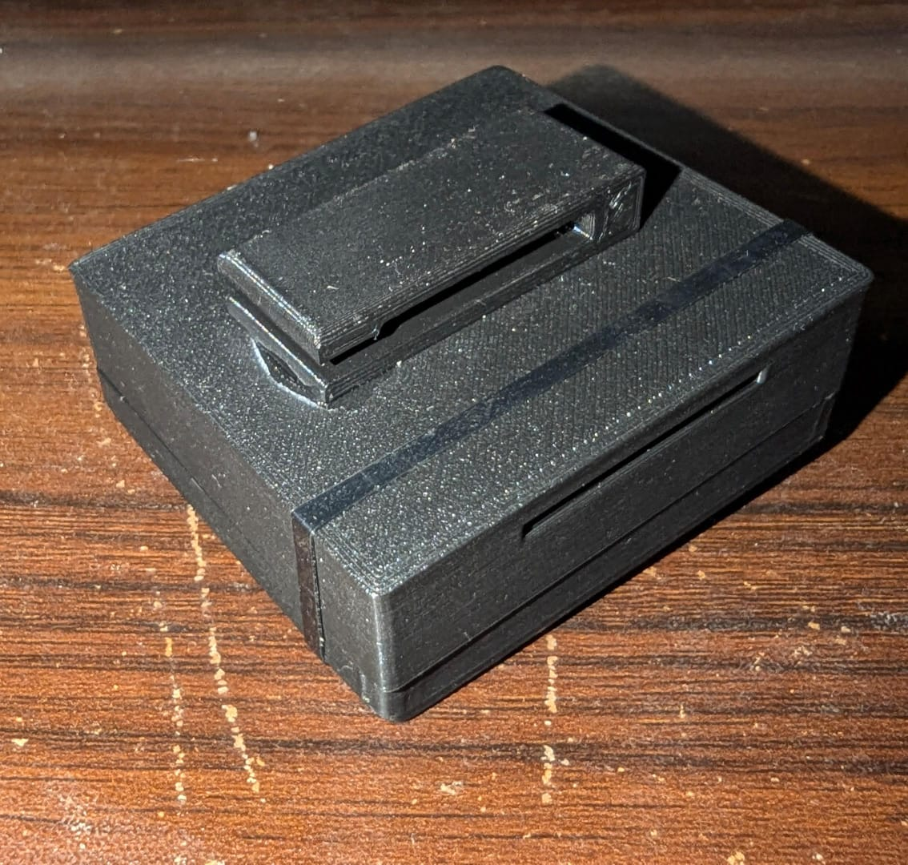
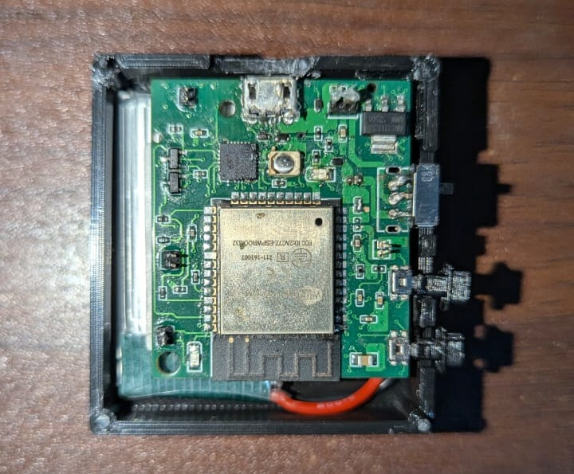
FINAL PRODUCT

Slide 14
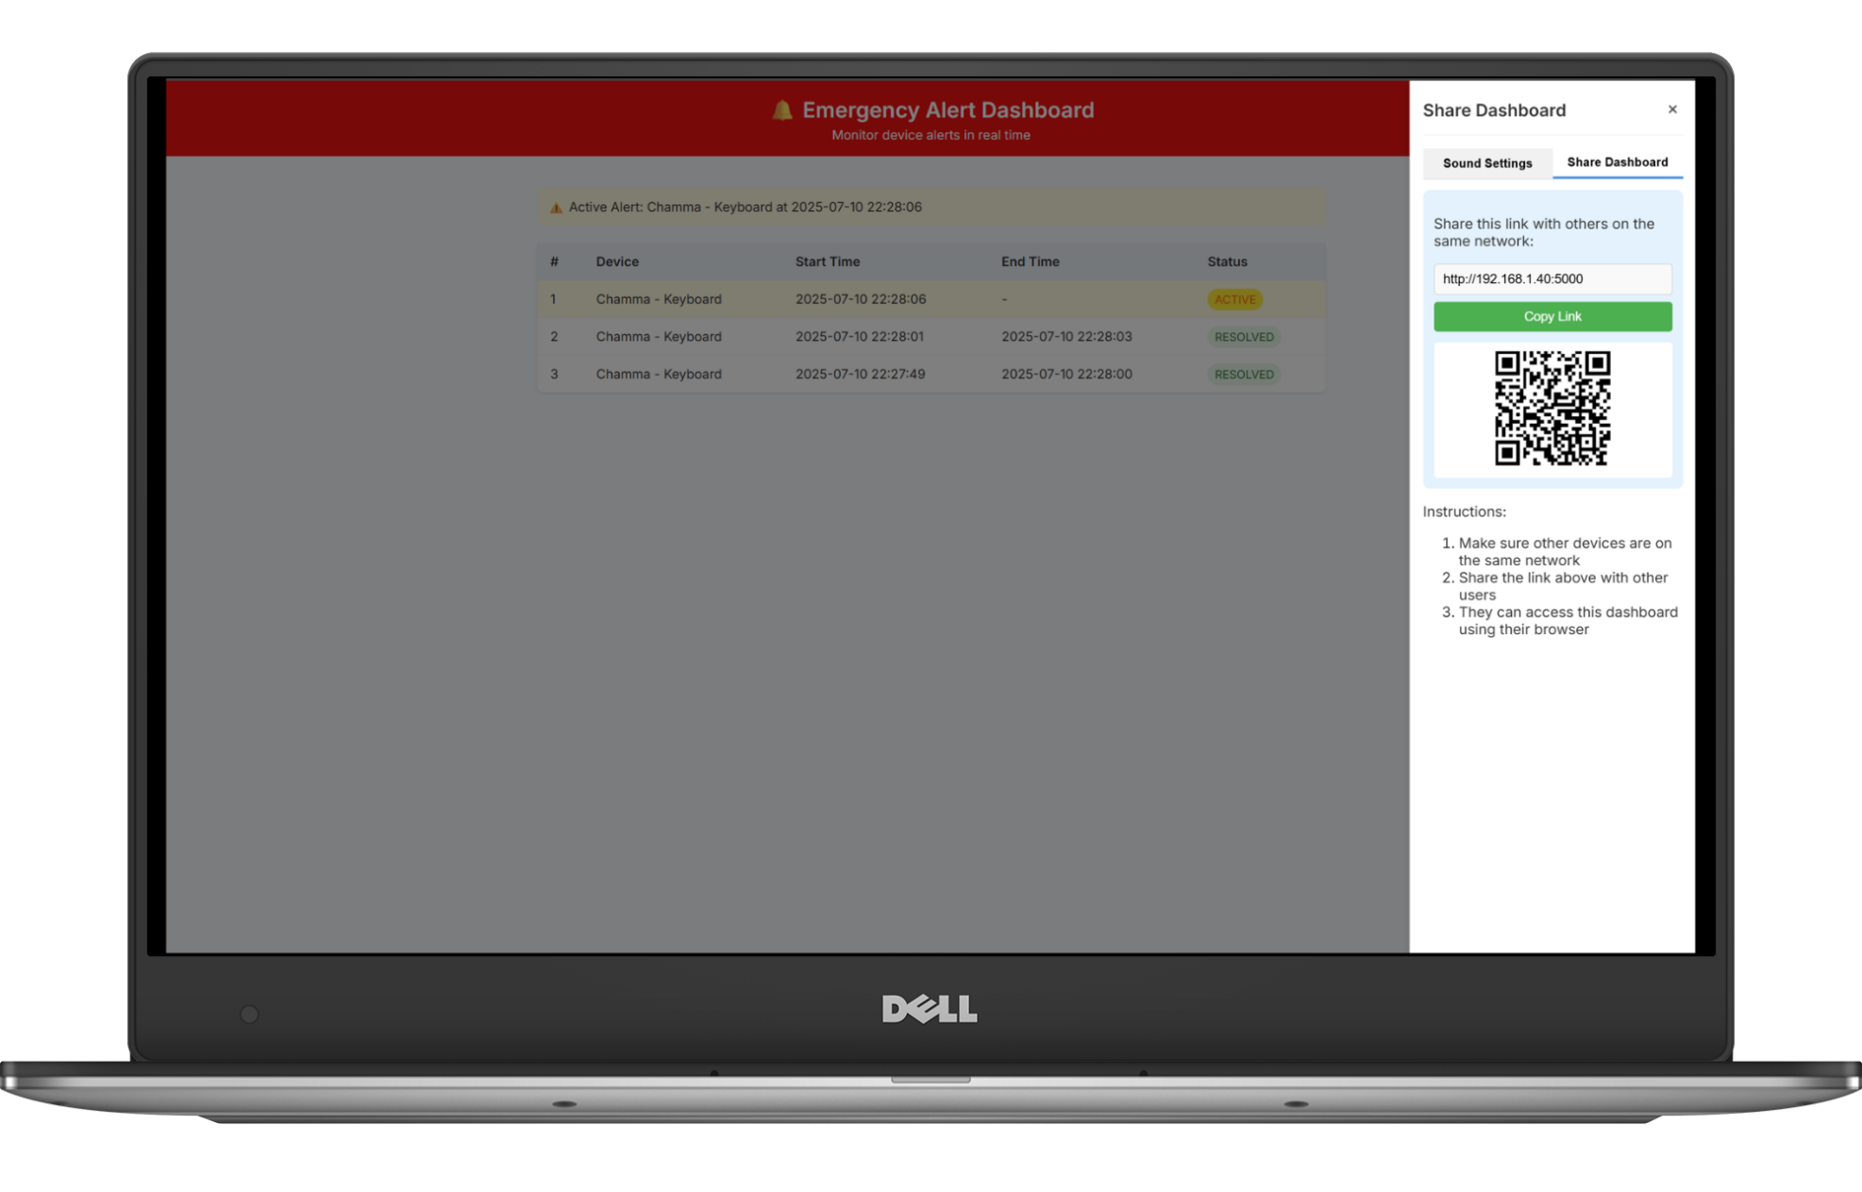
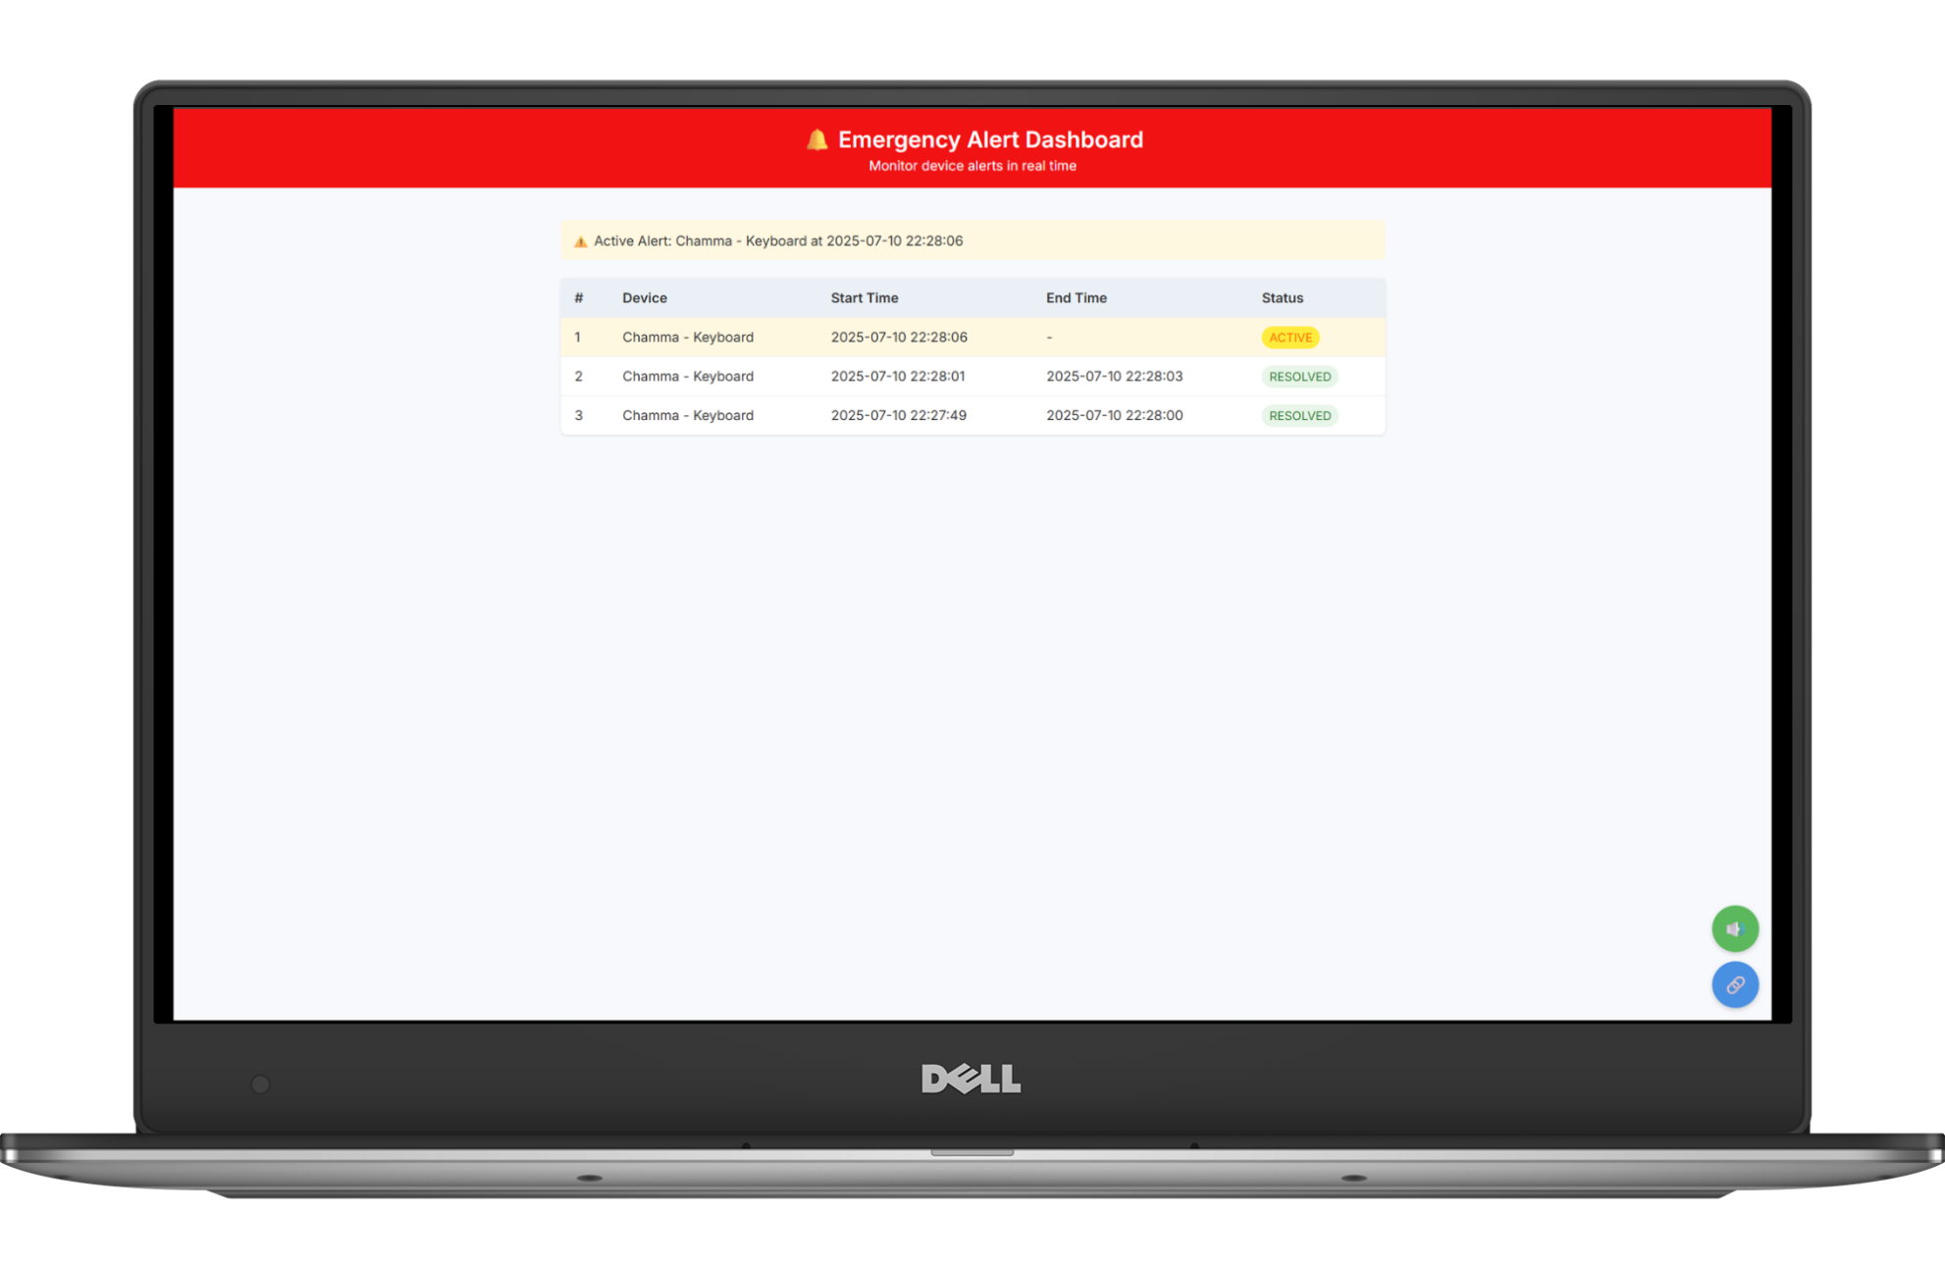
WEB APP

Slide 15
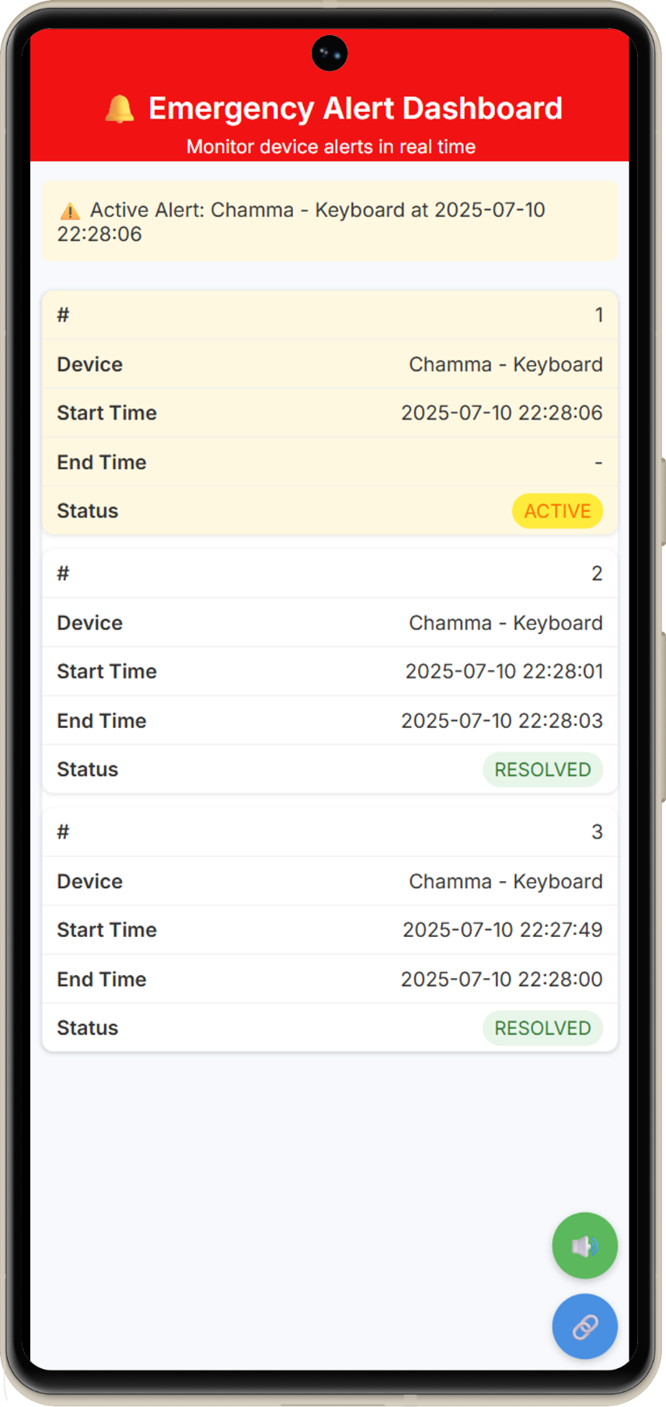
WEB APP

Slide 16
CHALLENGES & SOLUTIONS
Reliable Communication - Used local Wi-Fi with a dedicated server to ensure stable, low-latency alerts without internet dependency.
Configuration Complexity - Device setup via hotspot with simple UI and used enhanced captive portal and a single setup file to run server with single click.
Compact & Wearable Design - Wristband-style enclosure for comfort and mobility during performances.
Multi-User Scalability - Unique IDs assigned to each device; alerts clearly labeled on receiver screen.

Slide 17
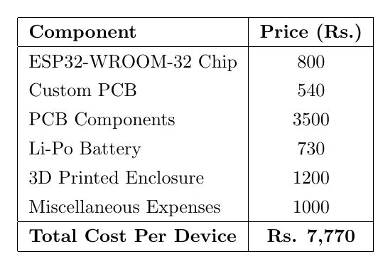
FINAL BUDGET

Slide 18
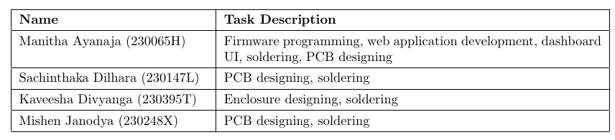
TEAM CONTRIBUTION

Slide 19
Thank You!

